Slide 1
Product Review Analysis - FlipKart/Amazon
FMCG data analysis - with Machine learning and NLP.
By, Panneer Selvam R

Slide 2
1. Problem Statement
In an ecommerce platform it is difficult to clearly understand the customers feedback on a mobile.
The problem here is to analyze the NLP data of customer reviews and provide ratings for a particular mobile based on the reviews.
We have 8 mobile catagories
Redmi 9 Activ Carbon Black
OPPO A31 (Mystery Black
Redmi 10 Prime
OnePlus Nord CE
Redmi Note 11
realme narzo 50A
vivo iQOO Z6 5G
Samsung Galaxy M32

Slide 3
2. Tools Used
The tools used were (Python, Pandas, Matplotlib and Seaborn.
Python was for all the coding purposes.
Pandas, Matplotlib and seaborn was to plot the data.
apart from that ML tools were used:-
Knn, Decision Tree, Random Forest and XGBoost.
The data was a clearly imbalanced classification data, so we have also included “Smote Enn” approach to under sample and oversample.
Our classification is between the 5 scale of ratings ‘1’, ‘2’, ‘3’, ‘4’, ‘5’.

Slide 4
3. Approaches
The first problem was the imbalance in the data so after all the cleaning process we decided to scale and also use smote enn.
To clean the NLP data we have removed the spaces with our own code and we have first lemmatized and then removed the stop words to maintain the quality of the data.
TFIDF approach was also used to remove unwanted words.
Then as the data is clear we have converted to numbers and then the machine learning models have been applied.

Slide 5
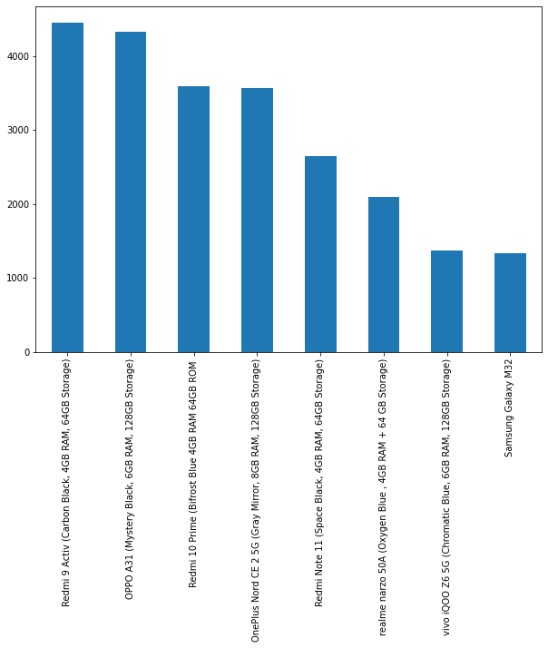
4. EDA Insights
Count Plot :-

Slide 6
4. EDA Insights
Count Plot Interpretation:-
We see that the Redmi9 active has the leading sales in the data.
This decreasing order can be interpreted as the customer's idea on a product. We can also say how the marketing has to be improved.
This order also explains the customers preference to features and price involvement.
As a personal suggestion-
Companies like Samsung provide very good processors, but people are very less educated on the processor quality.
As a brand their products in terms of battery also can be still communicated in a better way.

Slide 7
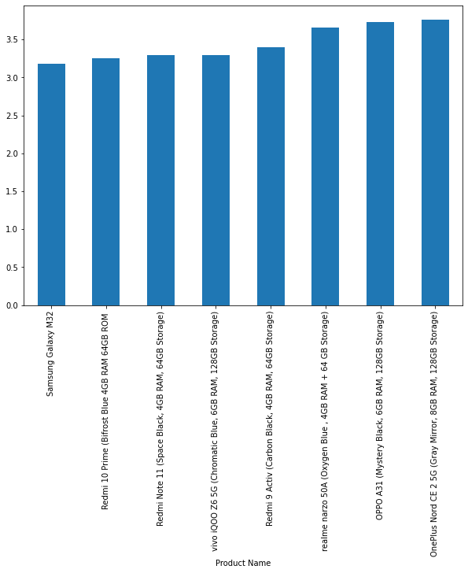
4. EDA Insights
Rating (mean) Plot :-

Slide 8
4. EDA Insights
Rating(mean) Plot Interpretation:-
The rating is in mean because the difference can be better identified.
We can see that all the products mean rating lies between 3.5 - 5. which is a very good insight, here all the products are leaders in the market so, passing comments on the quality will not be a proper judgement.
we also see that redme9 has leading sales but the reviews have come to the average as the experience on other important factors of mobile had a bad user experience.
For this data the advertisement level is to be judged and also the customer segments has been cleanly decided by the one plus brand. They do not have mobiles under 18k. Which actually influences but dose not cover in our analysis.
Samsung stands at the least both in purchase and the ratings. This is also just an insight on the consumers perception.

Slide 9
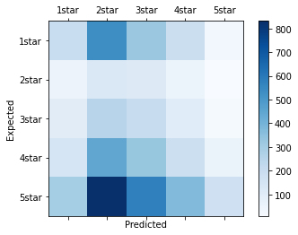
5. Best ML Model
Knn :-
Knn had a learning score of 0.91 but since its is an nlp data we can understand that the predictions were not accurate and the nearest neighbors were 3.
The confusion matrix along with the values has been stated in the left.
The model has basically predicted the ratings from one to 5 as classes.
Xgboost ran for over 7 hrs and was not able to complete so we did not continue with it.
The dectiontree had 0.54 as the score so we ignored the model.
[200 535 323 195 30] [ 56 127 115 53 9] [102 251 203 103 20] [150 448 331 189 61] [301 832 575 373 177]

Slide 10
6. Evaluation Metrics of Model
We have use cross validation as the evaluation metric and the number of folds were 9.
Best fold was analyzed by feeding multiple values from the range of 1-10 into the for loop and the model actually executes multiple time to find the best score.
The cross fold of 9 gave the best result.
This was the only metric used as it preforms best.

Slide 11
7. Future Development
The data had full of NLP features.
Title of the review.
Body of the review.
Ratings(target)
The product names as a feature.
We see that there was not a much of new feature to be derived from the existing ones.
So we have literally not derived any of the new feature.
If this problem was a K-Means clustering one then the ratings could have been an added feature and we would also be developing regions where these mobiles fall. And would have been better at prediction but. The problem statement clearly mentioned as the classical machine learning. We have not used clustering.

